Slide 1
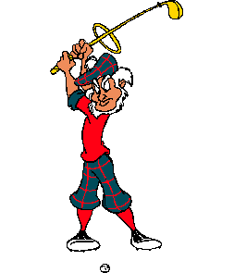

Midwest City senior golf association
Age distribution chart
15
14
13
12
11
10
9
8
7
6
5
4
3
2
1
N
U
M
B
E
R
O
F
G
O
L
F
E
R
S
Age 55 56 57 58 59 60 61 62 63 64 65 66 67 68 69 70 71 72 73 74 75 76 77 78 79 80 81 82 83 84 85 86 87 88 89 90 91 92 93
149 Members (As of 7 Dec 25)

